Slide 1


Slide 2
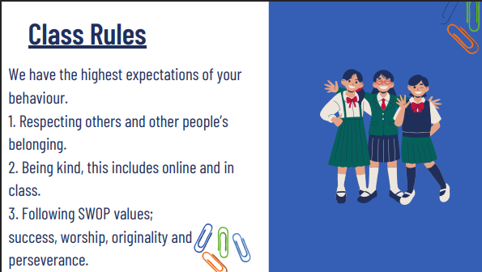

Slide 3
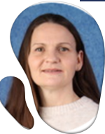
Hello, I am Mrs Tong. I joined the SWOP team in 2025 as Deputy Head and know what a special community this is. I am blessed with two children, and I have been teaching for 20 years. I have a passion for reading, Parkrun (even if I am slow) and the arts.
This year in Year 3 we have Mrs Weaver, Mrs Crispe and Miss Lane. Our team work hard to make learning engaging, fun and progressive. We have planned for a range of topics to help create a broad curriculum and really aim to ignite a child’s passion for learning over the course of the year.
Please see me if you have concerns.

Slide 4
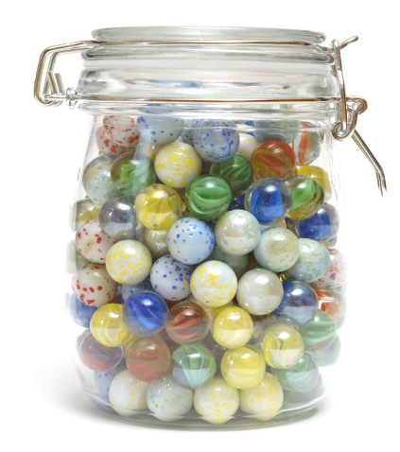
Rewards and Restoration
Star of the day.
Marble jar.
Peg system.
Orange slips.

Slide 5
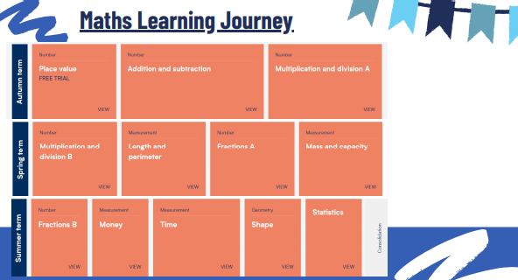

Slide 6
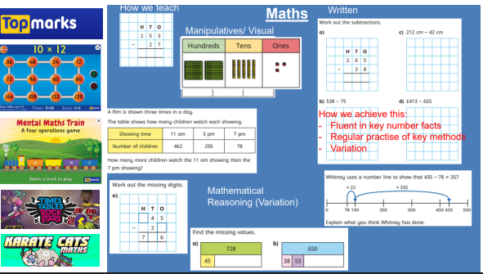

Slide 7


Slide 8
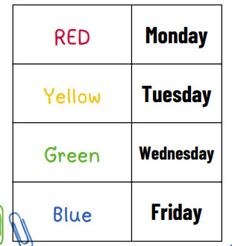
Please read daily.
Please sign the Reading Contact book.
Library book day is a Monday.

Slide 9
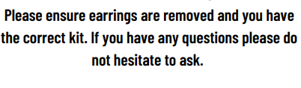
PE
This is a valuable part of the National Curriculum.
Monday- Inside (E.g. Yoga, dance, gymnastics)
Wednesday- Outside games (netball, athletics, ball skills)
Tuesday- Swimming (normally Summer term)
Details will be given out nearer the time.

Slide 10


Online Safety
NHS: Advises that older children should have no more than two hours of recreational screen time daily. It encourages parents to prioritize sleep, physical activity (at least 60 minutes a day), and social interaction.
NICE (National Institute for Health and Care Excellence): Suggests that children should have screen-free days or observe a two-hour daily limit.
https://www.nspcc.org.uk/keeping-children-safe/online-safety/

Slide 11
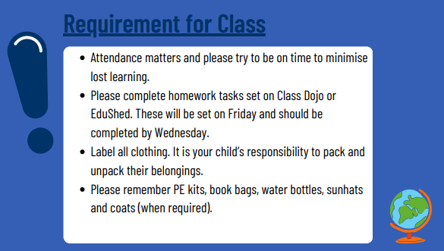

Slide 12
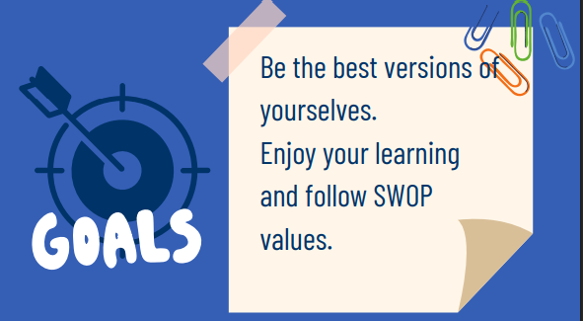

Slide 13


